Slide 1


Practical Data Science with Python – Assignment 1 Part 2
Varun Ramesh
s3793675

Slide 2
Data Preprocessing
1) Data Retrieving
2) Checking Data Types
3) Upper/ Lower Cases
4) Extra Whitespaces
5) Typos
6) Sanity Checks
7) Missing Value

Slide 3
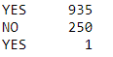
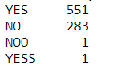
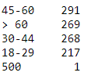
Steps taken to pre-process Data:
Data Retrieving | Data Types | Upper/ Lower cases | Extra Whitespaces | Typos | Sanity Checks | Missing Values
The star wars data was multi-indexed | All the columns were textual data and had to be of object type | Changing all the text to upper case for uniformity |  |  |  | Some missing values (not watched the movie) which was needed was changed to ‘false’
Columns were renamed | Using the function dtypes, the data types were observed | This ease the task to be done for further cleaning | White spaces in data can be hard to find and need to be removed | There were many typos as shown in the above picture | Age column had an age of 500 as seen above. This was removed | Other missing data was removed.
Nominal Data such as ID was removed |  |  | After using the strip function, the data had no whitespaces | These were removed using the replace function |  | Data was sub-settled for each task and cleaned separately

Slide 4
Exploration and analysis
The following columns were used to do exploration and analysis:
Comparison of ranks of movies watched
Comparing Fans of StarWars and their Age
Comparing Fans of StarTrek and their Age
How have the fans answered the question ‘Which character was shot first?’
Relationship between people’s demographics(Gender, Age, Household income, Education, Location) and their attitude to Star War characters

Slide 5

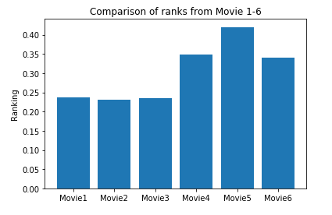
Ranks of Movies
All the ranks of the movies were in object type. Converting them to float type for better to take mean
Taking only essential columns, the mean of each of those were stored in a dictionary along with the column names
Here best rank was given 1 and worst was given 6. This is why inverse was taken to make the graph look more ideal. This way we can say Movie 5 was rated the best and Movie 2 the worst.

Slide 6
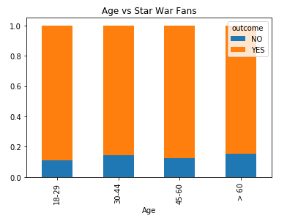
Star War fans vs Age
Taking value counts of Age and fans we can see which group is of the maximum number.
Normalizing data to get more it fair as both the columns were scaled differently.
Using groupBy function we can get a stacked bar chart.
We can see that the age group 18-29 had the highest fans. Followed by 45-60, 30-44 and then finally >60 age group.

Slide 7
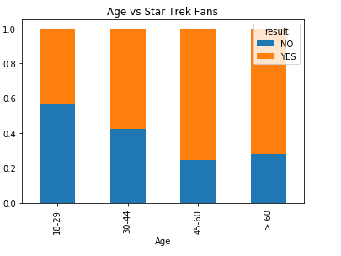
Star Trek Fans vs Age
Following the same method of exploration as it was done in Star war fans vs Age , we plot this graph.
The graph which is shown on the right makes us conclude that maximum fans are in age group between 45-60 years. This can be justified because star trek is a relatively old movie compared to starwars.

Slide 8
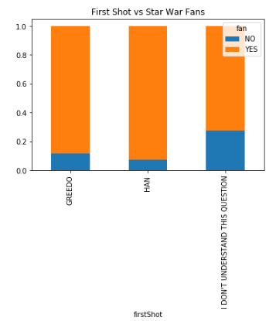
Star War Fans vs which character was shot first
Sub setting the data frame with the question and fans.
The columns were renamed for simplicity and value counts for the two columns were taken and were plotted against each other
It can be observed that Han Solo is the right answer to who was Shot first, perhaps the fans were confused with the question and chose Greedo as he shot Han Solo.
Most of the non fans chose I do not understand the question.

Slide 9

Character vs demographics
5 different plots were made for different demographics.
Exploration was done in a similar pattern for all demographics. The following steps were undertaken:
Characters vs Target demography was taken and was sub-setted from the dataset.
Object type dataset was converted into int type by using data levelling technique.
GroupBy function was then used to create a dataframe with value_counts of each column.
The characters were then plotted against each other as shown in the graphs in next few slides.

Slide 10
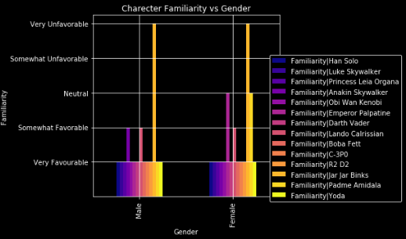
Characters vs gender
As shown Jar Jar Binks (yellow) is highly unfavourable by both the genders.
Females considered Emperor Palpatine (pink) Neutral.
Men however considered Anakin Skywalker (purple) Somewhat favourable while female were very favourable.

Slide 11
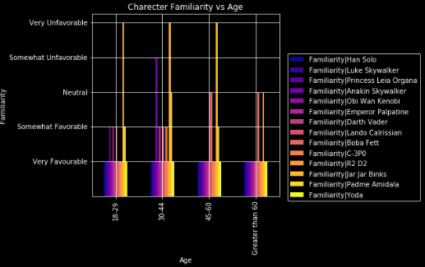
Characters vs age
Here again all the age groups consider Jar Jar Binks (yellow) unfavourable.
Age group of 18-29 years consider Anakin Skywalker somewhat favourable while the age group of fans between 30-44 consider Anakin Skywalker somewhat unfavourable. This points at two completely opposing views.
All other characters have similar opinions among different age groups.

Slide 12
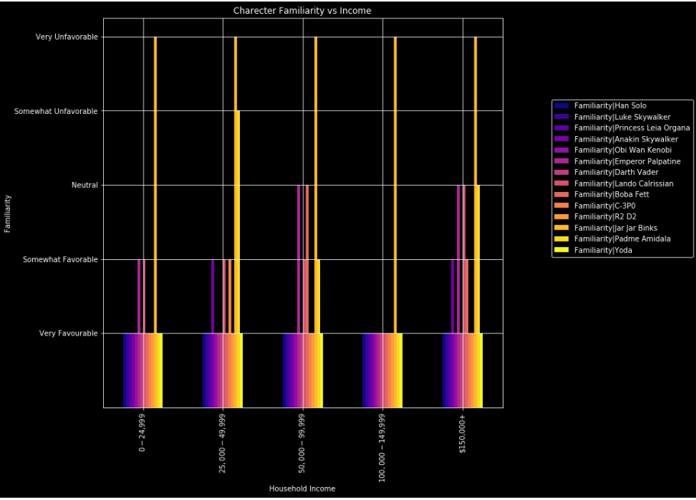
Characters vs Household income
As shown from the graph we can see everybody has an unfavourable opinion about Jar Jar Binks.
The most varied opinion is by household income $150K+ and following is $50K-$99K. Both these income groups consider Darth Vader as Neutral.
All income groups consider Lando Calrissan as either somewhat favourable or Neutral.

Slide 13
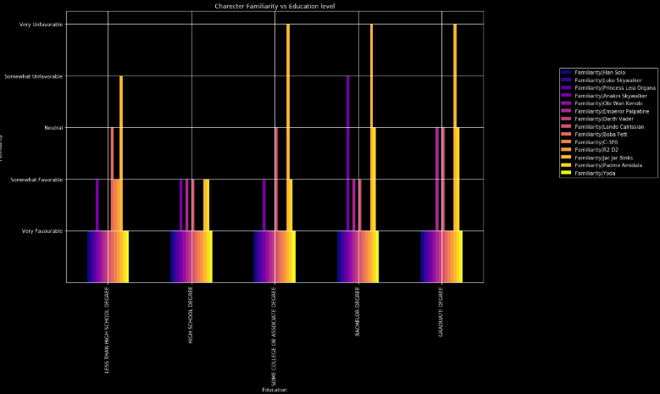
Character vs education
Most varied opinion is given by people who have completed less than high school education. They consider C-3P0, R2D2 as somewhat favourable while everyone else considers them very favourable.
Nobody considers Padme Amidala (last but one in yellow) very favourable other than surveyors who have completed less than high school.
Bachelor’s Degree holders consider Anakin Skywalker somewhat while no other group does so.

Slide 14
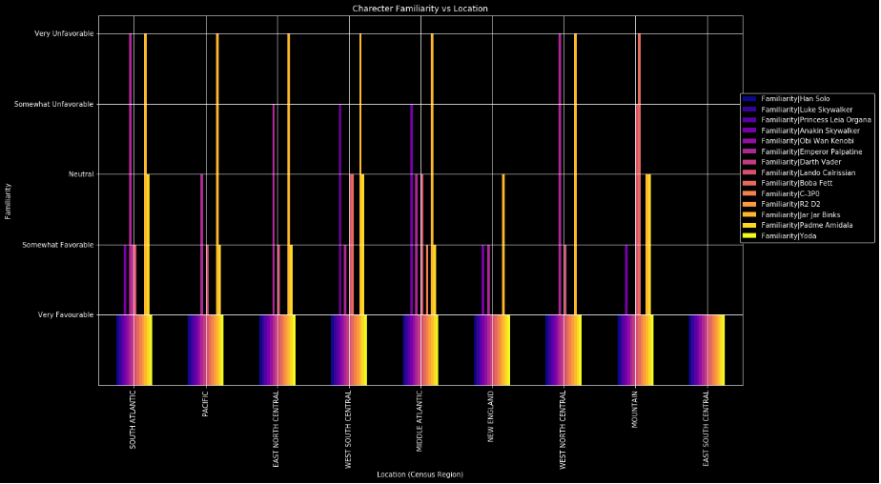
Character vs location
Everyone other than Mountain and East South Central has varied familiarities on Emperor Palaptine.
People from Pacific, East North Central, West South Central & Middle Atlantic found Padme Amidala somewhat favourable
East South Central had everyone very favourable because there were not enough observations in that region.

Slide 15
So are you a fan of starwars now? Thank you

